Slide 1
Saving Birds, One Building at a time
Presented by Lindsay Jacks, Director

Slide 2
What is Migration?
When animals (like birds) move from one place to another at a certain time of year.
Many types of birds spend the winter in warmer places and come back in the spring and summer.

Slide 3
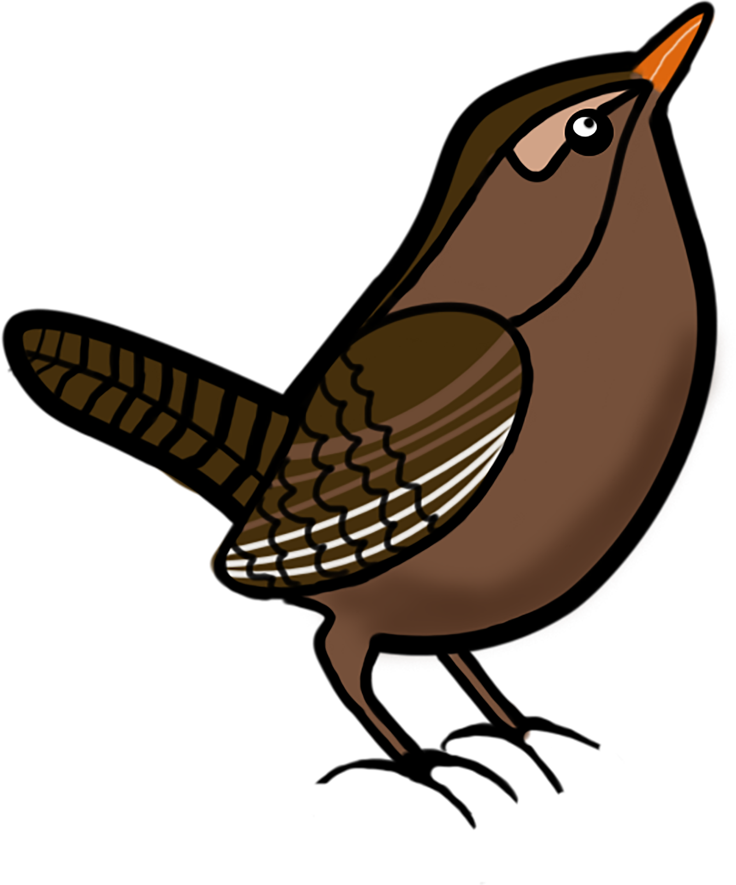
Why are migratory Birds important?
Migratory birds pollinate plants that give us food.
Migratory birds spread seeds that become plants that are important to other animals.
Migratory birds eat insects that are pests to humans.
Migratory birds are an important part of many food webs.

Slide 4
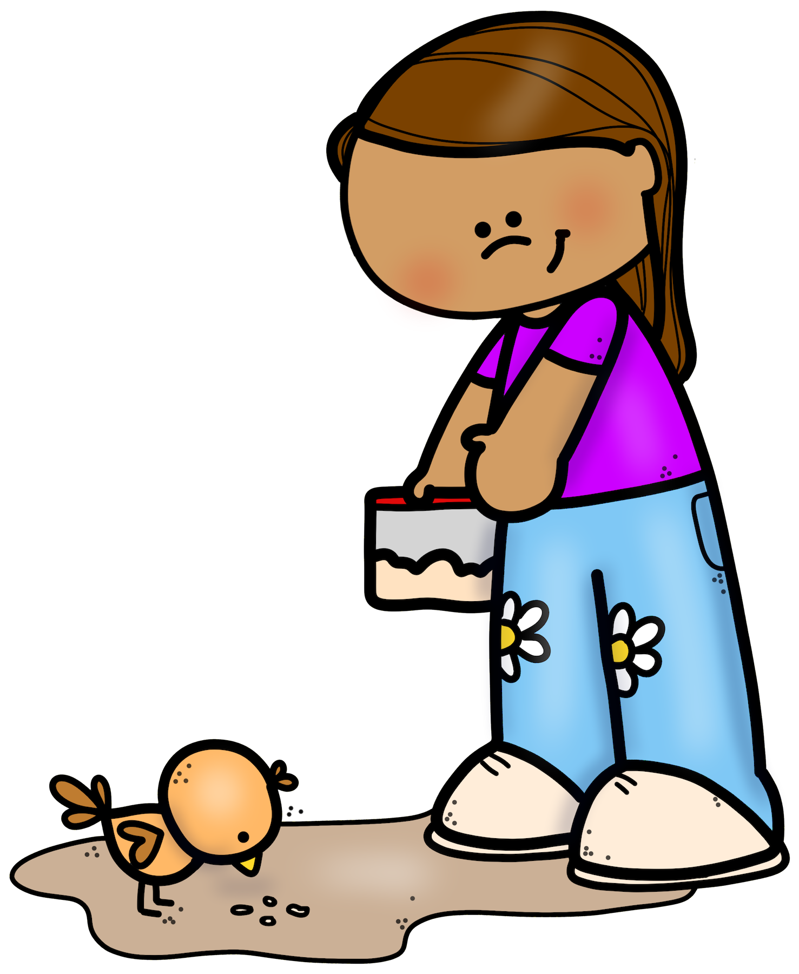
What’s the problem?
Birds use the light of the moon and stars to guide their way. Lights from homes and buildings can be very confusing! This can cause birds to crash into those buildings.

Slide 5
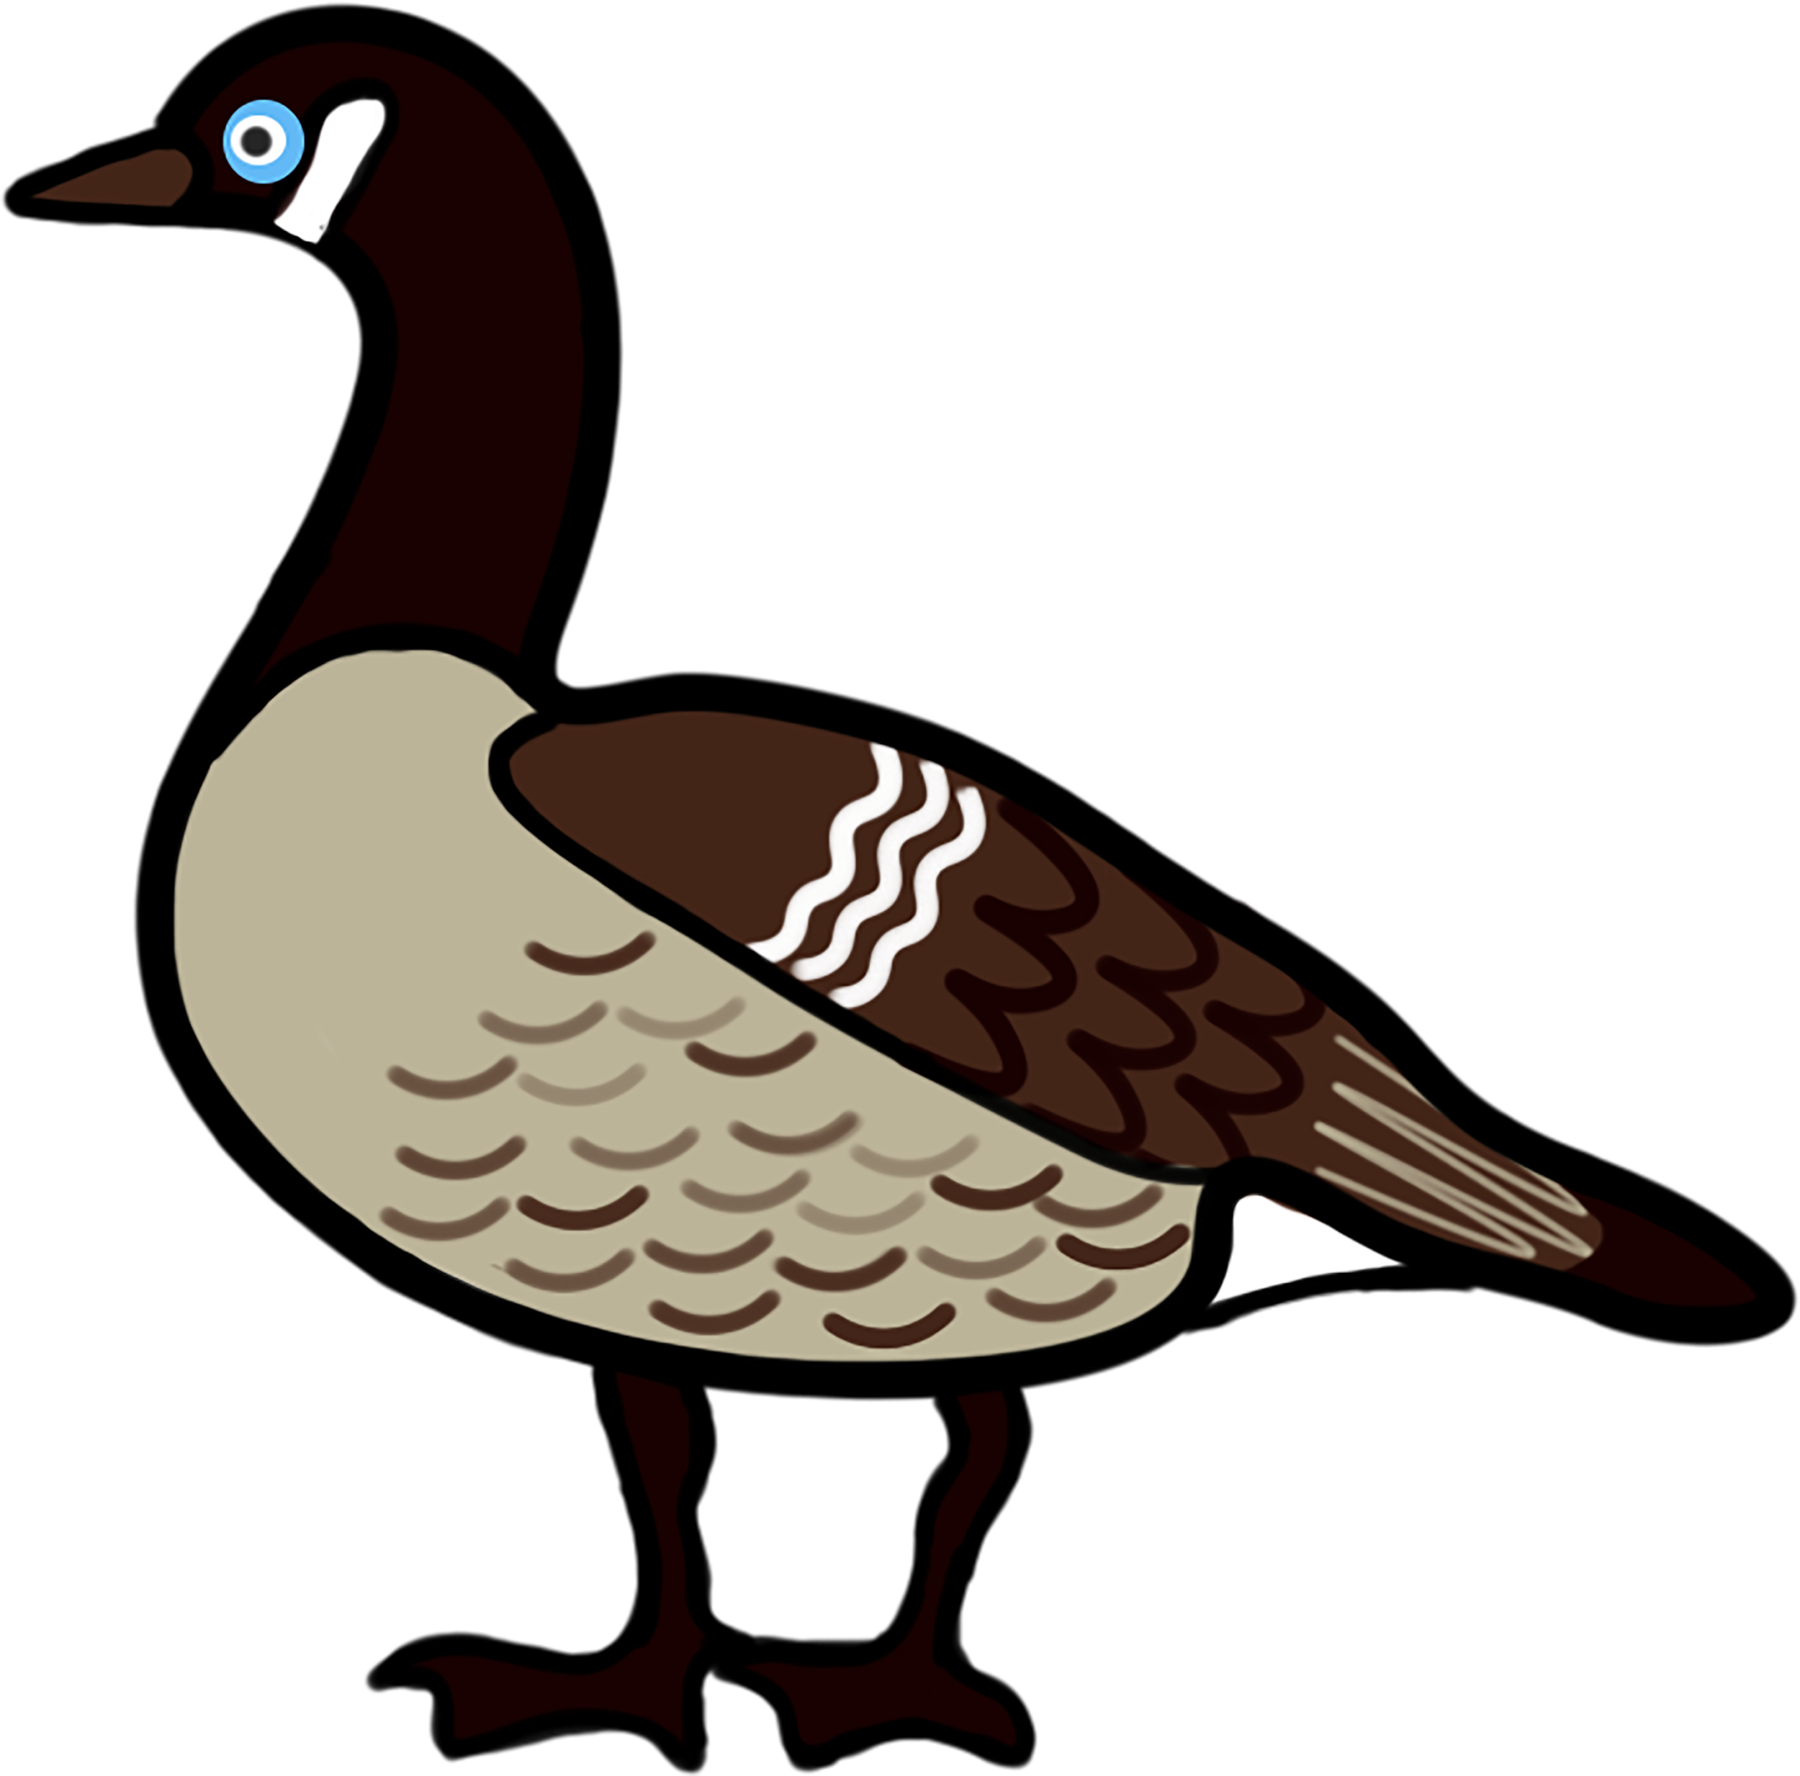
How bad is it?
100 million to 1 billion birds crash into buildings and homes each year. Each home can have 2 to 10 bird hits per year.

Slide 6
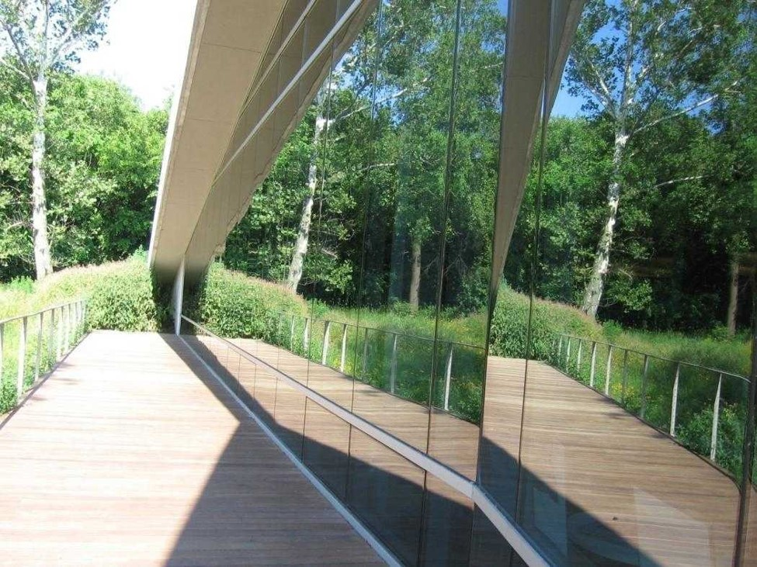
What does it look like for a bird?
Take a look! A bird can’t tell what’s a reflection and what’s real!

Slide 7
So, What does “Lights Out Baltimore” Do?
We were founded in 2008 as a project of the Baltimore Bird Club.
Our goal is to make Baltimore safe for migratory birds.
We encourage businesses to turn their lights out.
We advocate for bird-friendly building designs.
We talk to lawmakers about keeping birds safe.
We teach others how to make glass visible to birds.
We monitor for bird collisions during migration season.

Slide 8
What happens when a bird hits a window?
Lights Out Baltimore takes injured birds to the Phoenix Wildlife Center so they can be cared for until they have healed.
Birds that pass away are taken to the Smithsonian’s Natural History Museum or the Johns Hopkins University School of medicine to help scientists with research.

Slide 9
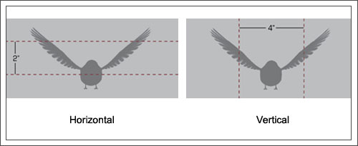
How can we protect birds?
On windows, we use the 2 x 4 rule.

Slide 10
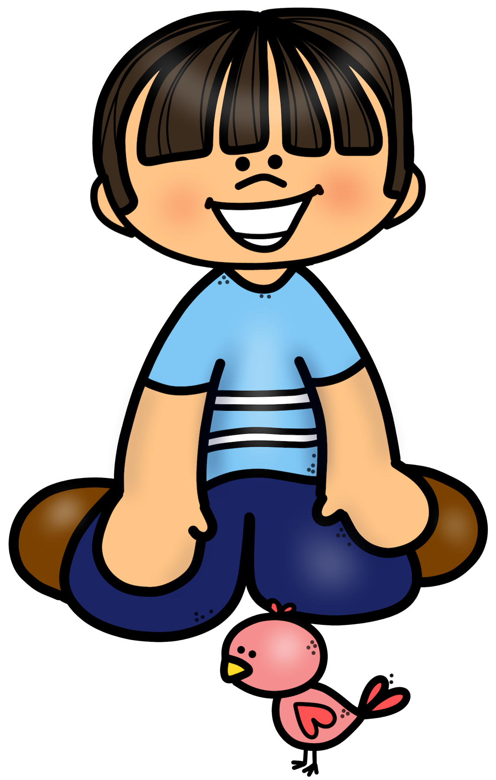
What do we put on windows?
Temporary | Permanent
Chalk markers | CollidEscape
Soapy water | Solyx Bird Safety Film
Tempera paint | Feather-Friendly film
Cover the glass at night

Slide 11
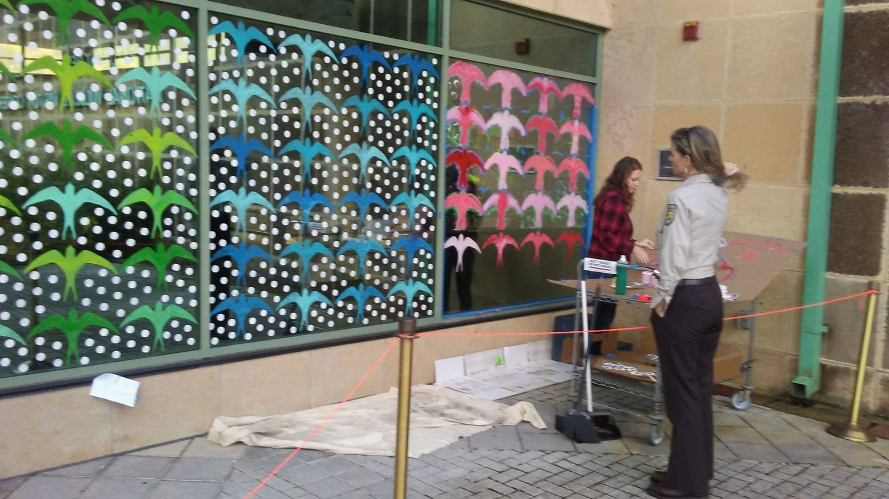
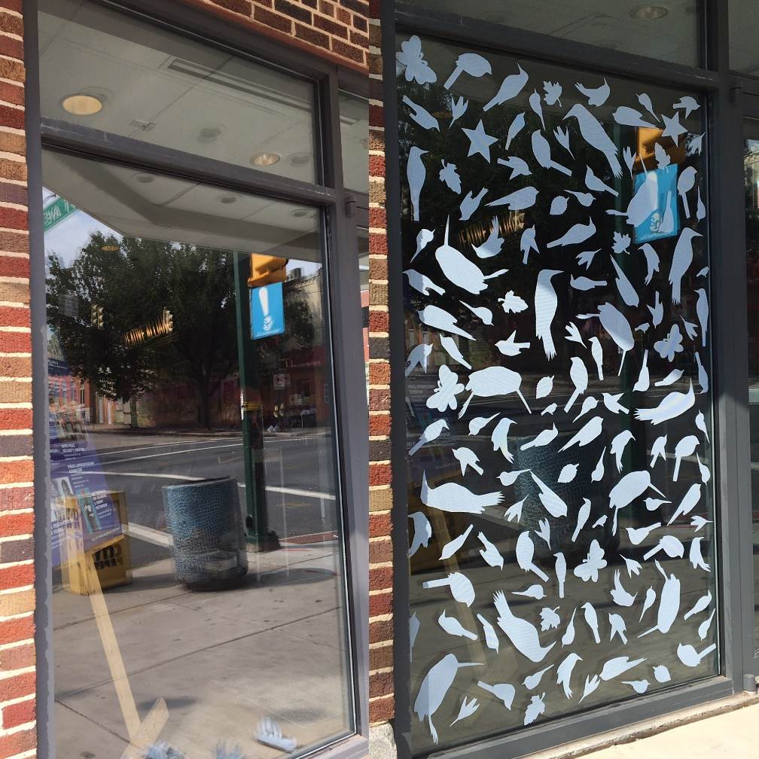
What does that look like for Birds?

Slide 12
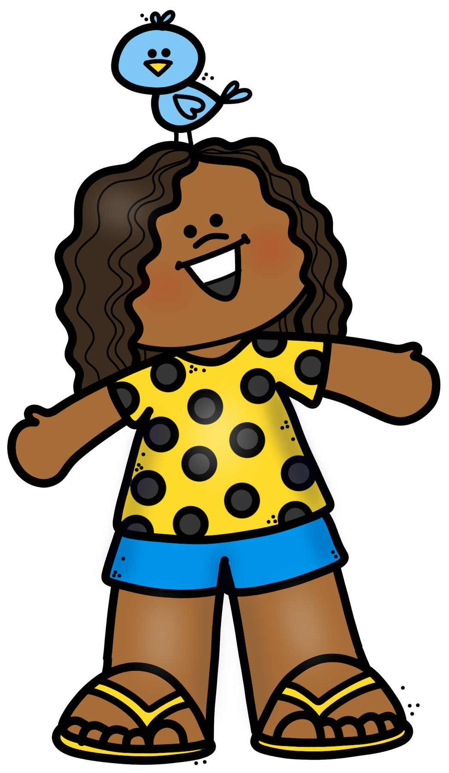
Are there other things we can do?
Have a bird feeder close to the window (five feet or less away)
Turn off lights between 10pm and 6am
Tell other people about saving birds!

